Slide 1
I am currently selling a rental. Owners moved to Oregon 3 years ago and wanted to rent the property they had in Mountain View. Due to all the CA housing restrictions and ever increasing taxes, they decided to sell this property and invest in Oregon.
- Nicole C

Slide 2


Story Power
Lessons Learned from the Moratorium Front Lines

Slide 3

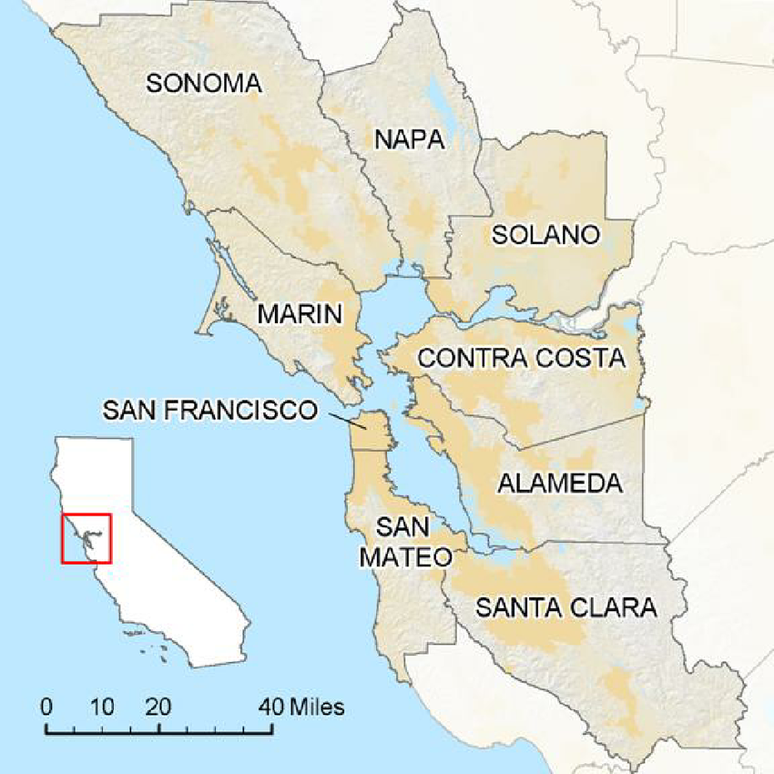

Slide 4
East Bay Political Landscape
Historic and ongoing regional Jobs/Housing imbalance
Policy makers favor short-term fixes vs. long-term solutions
Local government inaction is NOT an option
Tenant advocates have the emotional high ground

Slide 5

Regulatory Trifecta
State-wide eviction moratorium
Alameda County eviction moratorium
Local eviction moratoria and tenant protections
More regulations could be coming

Slide 6
We are losing 2 to 3 rentals a month due to owners being fed up with California. One owner is selling all 3 of his rental homes as well as his own home and he is moving to Florida. Another owner is already on the east coast and is selling her Pleasanton rental home.
- Ken B

Slide 7
Your Results May Vary
Political climate
Public support for housing providers and housing supply
Sympathetic policy makers
Member mobilization
Work with your GAD ASAP

Slide 8

Defining Victory
Philosophical
Protect Private Property Rights
Practical
Carve-out for 1-4 units
Keep Mom ‘n Pops in the rental business

Slide 9

Next Steps – Assistance and Advocacy
Identify
Identify member and rental housing provider needs
Help
Help Mom ‘n Pops access assistance programs
Story
Story Power – Collect and share experiences now

Slide 10
Plot Points
Rental housing industry NOT monolithic
Mom ‘n Pops = affordable / BMR housing
Good intentions = unintended consequences
Net loss of rental housing supply
Foreshadowing: Action today = reaction later

Slide 11
Ten properties so far in one year. If this keeps up, I will soon close up shop on the property management. There are so many better places to invest than California especially the cities located in the Bay Area.
- Richard H

Slide 12
For more information
David Stark
Chief Public Affairs and Communications Officer
Bay East Association of REALTORS®
Telephone: (925) 730–4068
Email: davids@bayeast.org

